Slide 1
Confidence Intervals
R. Garner, DePaul University

Slide 2
A method of statistical inference
Constructing a confidence interval is a way of using sample data to reach a conclusion about a population—i.e., statistical inference.
With this method we will use a value (often a mean or proportion) that we found in our sample data to set up an interval that we feel “pretty sure” includes the population value (parameter) we are trying to find.

Slide 3
A few examples
Driving times: Based on a lot of drives from Edmonton to Calgary, how long can we expect to be on the road?
Industrial processes: Based on a sample of widget assembly times, how long does the assembly take on average?
Natural processes: What is the gestation period of raccoons? How long will it take for my basil plants to grow edible leaves?
Votes: Based on polling data, is Candidate X likely to win?

Slide 4
“Pretty sure”?
“Pretty sure” is a way of saying that 95% of the intervals we construct with our method actually do contain the population value (parameter) that we want to find.
Sometimes we aim at 99% of the intervals containing the value, but in order to be that confident, we have to make our interval wider.

Slide 5
Sampling error and the normal distribution
Remember that sampling error (variability of sample outcomes) is distributed normally, and the outcomes of most random samples we might draw are within plus or minus two standard errors of the population value.
The standard error is a special standard deviation—it is the standard deviation of the sampling distribution (the distribution of all the sample outcomes).

Slide 6
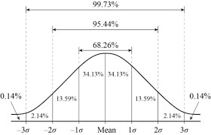
The Normal Curve
95% of sample means will be within + or – 2 standard errors of the population mean

Slide 7
The procedure
Let’s focus on a confidence interval for the population mean, mu, μ.
We are going to define our interval by specifying an upper confidence limit (UCL) and a lower confidence limit (LCL).
We are going to construct our interval by finding the sample mean and first adding two standard errors (i.e., SDs) for the UCL and then subtracting two standard errors for the LCL.
95% of intervals constructed in this manner WILL include the population mean.

Slide 8
What about the bad 5%…?
In 5% of all the simple random samples we might draw, the sample value is so discrepant from the population value that it is not within two standard errors of the population value. These are samples with values “in the tails.” They are not very likely.
If we drew one of these “bad” samples, our constructed interval for the population mean would not contain it.

Slide 9
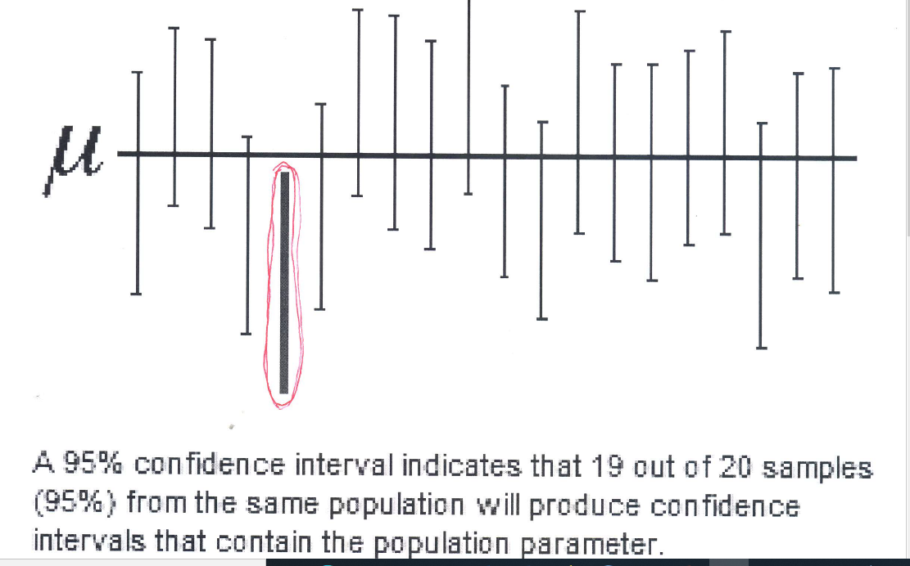
20 intervals—which caught MU?

Slide 10
A “miss” for only 5%
The interval we constructed that has a red line around it is one of the ones that produced a “miss”—it failed to “catch” the population mean, mu (lower-case Greek letter, μ, in the diagram).
UNFORTUNATELY, although a “miss” is not very likely, we do NOT know whether it happened or not—because the value of MU is unknown.

Slide 11
Formula for a 95% confidence interval
UCL = ‾X + Z(SE)
LCL = ‾X – Z(SE)
The upper confidence limit = the sample mean PLUS the standard error times the Z-value.
The lower confidence limit = the sample mean MINUS the standard error times the Z-value.
The Z-score we are looking for is the number of standard errors such that 95% of the sample statistics will fall within that number of standard errors from the population mean.
95% of the sample means fall within 1.96 standard errors plus or minus from the population mean.
We could round off 1.96 to 2 and it would be a safe value for Z, because it makes the interval just a tiny bit wider than 1.96.

Slide 12
Formula for a 99% confidence interval
UCL = ‾X + Z(SE)
LCL = ‾X – Z(SE)
To construct intervals of which 99% include the population value, we have to make them wider.
We use the same formula for the UCL and the LCL, but we have to include results that are a little more distant from the population mean.
We now have to use Z = 2.57 (about plus or minus two and a half standard errors).

Slide 13
99.7% confidence interval—very wide!
If we let Z = 3 in our formula, 99.7% of the constructed intervals will “catch” the population mean, but the intervals will be rather wide, which is not so great.
Example: I think it takes somewhere between 90 minutes and 2 weeks of driving time to get from Minneapolis to Winnipeg.
This is almost certainly true, but not so helpful—very wide interval, very confident we can catch the population parameter, but not very precise!

Slide 14
In practice, the t-distribution
Confidence intervals are usually constructed using the t-distribution because we don’t know the population standard deviation (σ), and so we use s (sample SD) instead for computing the standard error.
Using t instead of Z in the formula makes the interval a tiny bit wider, although if the sample size is larger than 100 (certainly larger than 120) it makes little difference.

Slide 15
Also proportions
We can construct confidence intervals for proportions (binary variable, 0 or 1 coding) and other population parameters.
The logic is the same as it is for the mean. We use the sample value and place it in the middle of an interval whose upper and lower limits are based on the number of standard errors needed to be confident (expressed as probability/percentage such as 95% or 99%) that the interval “catches” the population parameter.

Slide 16
What makes an interval narrow?
We would like a narrow interval that nevertheless gives us a high confidence level (like 95% or 99%). Here are two things that make it narrow—look at the formula!
A large sample size (large n in the denominator of the standard error).
A low degree of variability in the data (small s, presumably small σ) in the distribution and in the numerator of the standard error.
By dropping from 99% to 95% in our confidence level, we can make our interval more narrow.

Slide 17
Spotting confidence intervals in computer output
Software often reports statistical inference with a confidence interval as well as the p-value for a hypothesis test.
Looking at t-test results, we can see a 95% confidence interval. If 0 falls into this interval, it means that the two values we are comparing in the t-test are not statistically significantly different.

